Slide 1
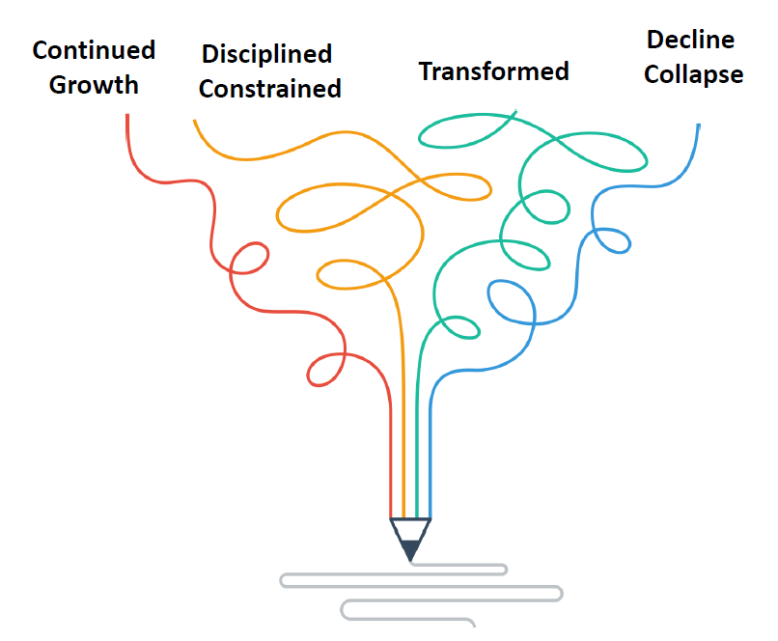
Four Futures – Assignment
Four Futures

Slide 2
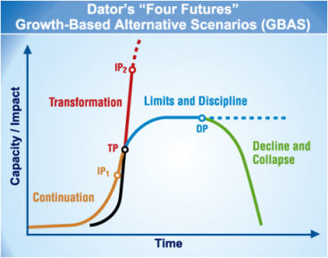
Four Futures refers to a set of scenario archetypes: Continued Growth, Disciplined/Constrained, Transformed, and Decline Collapse.
The original model was developed and popularized by Foresight Professor Jim Dator at the University of Hawaii.
While the framework has been used for years in the foresight community it was most recently codified in the Journal of Futures Studies November 2009.

Slide 3
The Assignment
We would like you to draft notes on your organization’s Four Futures for the 2020s-2030s time horizon.
Please complete ‘bullet point’ drafts for all four futures based on the template on subsequent pages.
Feel free to adjust the dates (though my preference is to show a ‘step by step’ story rather than a snapshot of your organization.
As you create your bullet points please try to integrate changes in the Green Bay region as well as your organization.

Slide 4
Four Futures Thinking
?
2008 – 2014
Continued Growth
Disciplined Constrained
Transformed
Decline Collapse

Slide 5
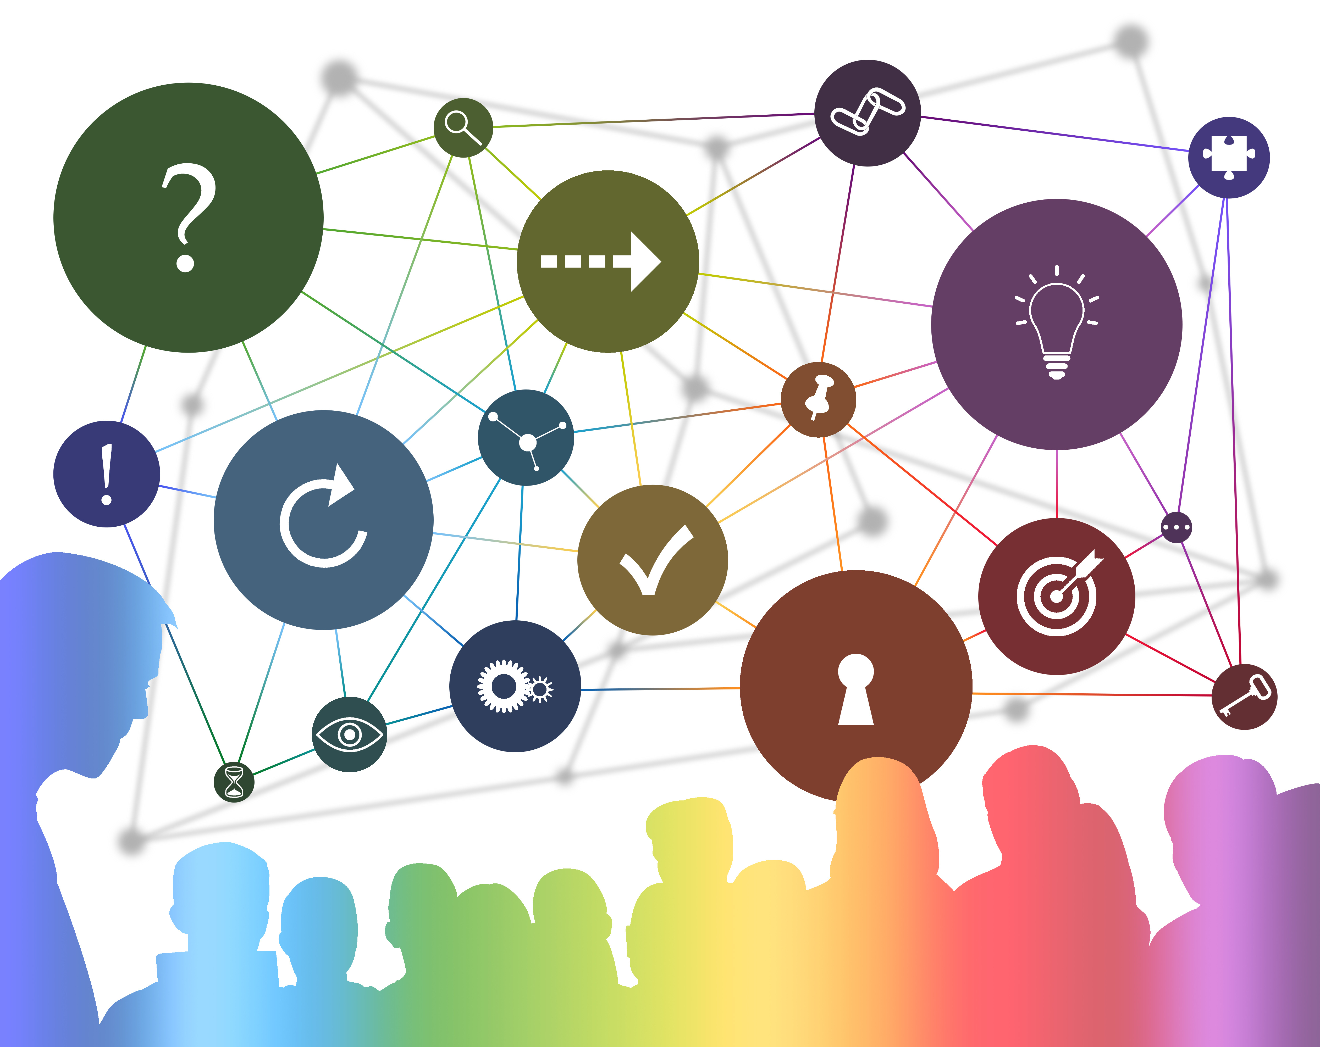
Task: Construct Your Four Futures
Continued Growth
Disciplined Constrained
Transformed
Decline Collapse

Slide 6
Storytelling Tips
Experiment with Story Structures
Multi-paragraph stories
Bullet points of storyline elements
Visualizations that communication the message
STEEP Forces of Change
Each scenario should include elements of the STEEP categories of change:
Society (Demographics / Culture)
Technology
Economy
Environment
Politics (Legal)
Three Mechanisms of Change Your scenarios should include:
1) Trends Slow moving changes over time; Language should be ‘more’ or ‘less’
2) Events Sources of discontinuity including:
Scheduled Events Plausible Events Wildcard Events (Low Probability, High Impact)
3) Choices Reflect our investments in people, partnerships and places.

Slide 7
Draft Name of Continuation Scenario
Continuation: Template
The Continuation Story
In 2021…
In 2023…
In 2025…
In 2029…
In 2030…
In 2035…
Evidence: Signals to Support this Scenario
Signal Title/Link
Signal Title/Link

Slide 8
Continuation
Continuation is story based on signals that reflect known knowns and extrapolation of generally positive forces. This scenario may be viewed as the ‘baseline’ (extrapolation) or ‘official future’ which reflect the shared (often unspoken) assumptions of an organization.
When you create the Continuation story it should include
Familiar stakeholders and partnerships
Policies, services & value offerings, and customer (citizen) needs
How you overcame new twists & turns along the way
The story should include challenges of new social norms and market dynamics but inevitably reveal how your organization leverages its core capabilities and ‘rides the wave’ of change.
?

Slide 9
Disciplined / Constrained
Disciplined/Constrained is a story of the future where your organization continues to operate in a traditional manner despite evidence that the world around you has shifted. Key organizational challenges are maintaining relevance and returning to growth.
When you create the Disciplined/Constrained story be sure to reveal:
Signals that suggest your current services and value offerings are less relevant or aligned to market and client needs.
Signals that challenge organizational culture or processes.
The story might surface how the organization’s inability or refusal to change has hit a ‘limits to growth’ phase. The story’s tone is not fatalistic but morale and expectations for growth are muted. You will survive but not thrive.
2008 – 2014

Slide 10
Draft Name of Disciplined / Constrained Scenario
Disciplined / Constrained: Template
The Disciplined-Constrained Story
In 2021…
In 2023…
In 2025…
In 2029…
In 2030…
In 2035…
Evidence: Signals to Support this Scenario
Signal Title/Link
Signal Title/Link

Slide 11
Transformed
Transformed is a scenario archetype where the world and organization have gone through an era-step change. Think caterpillar to butterfly – or Industrial to Information Economy.
The story should reveal how the organization (region) became something different. This may be the emergence of a new department or team. Or it might be a wholesale reinvention of the entire organization culture or value proposition.
The story tone is not utopian. There should be new problems and challenges that appear as expected – or as unintended consequences. Leave some issues unresolved.
The key story dynamic should show how the organization is empowered and feels in control of its future in this new world.

Slide 12
Draft Name of Transformed Scenario
Transformed: Template
The Transformed Story
In 2021…
In 2023…
In 2025…
In 2029…
In 2030…
In 2035…
Evidence: Signals to Support this Scenario
Signal Title/Link
Signal Title/Link

Slide 13
Decline / Collapse
Decline/Collapse is a scenario archetype where the world has changed and your company has not.
The Collapse Story connects signals that suggest:
Your imminent demise (e.g. Shut down firm; Merger)
An End of Growth (A Burning Platform)
Stagnation is challenging your culture
When you create the Decline/Collapse story be sure to describe both external conditions (outside-in changes) and internal actions (inside-out changes).
You might also emphasize inactions or decisions not made. The story may describe innovative efforts that failed and did not succeed as you attempted to transform the organization.

Slide 14
Draft Name of Decline/Collapse Scenario
Decline Collapse: Template
The Decline-Collapse Story
In 2021…
In 2023…
In 2025…
In 2029…
In 2030…
In 2035…
Evidence: Signals to Support this Scenario
Signal Title/Link
Signal Title/Link

Slide 15
Resource: Team Conversations
When the Four Futures are written, you should engage colleagues in answering strategic questions:
What signals or trends have you seen that might support the future described in each scenario?
What are the internal implications for our partners and teams? What might our customers (citizens) do differently to thrive in this future?
Where might the story go from here? Write a few extensions from this future.
What indicators or milestones might we monitor that represent a tipping point of this future?

Slide 16
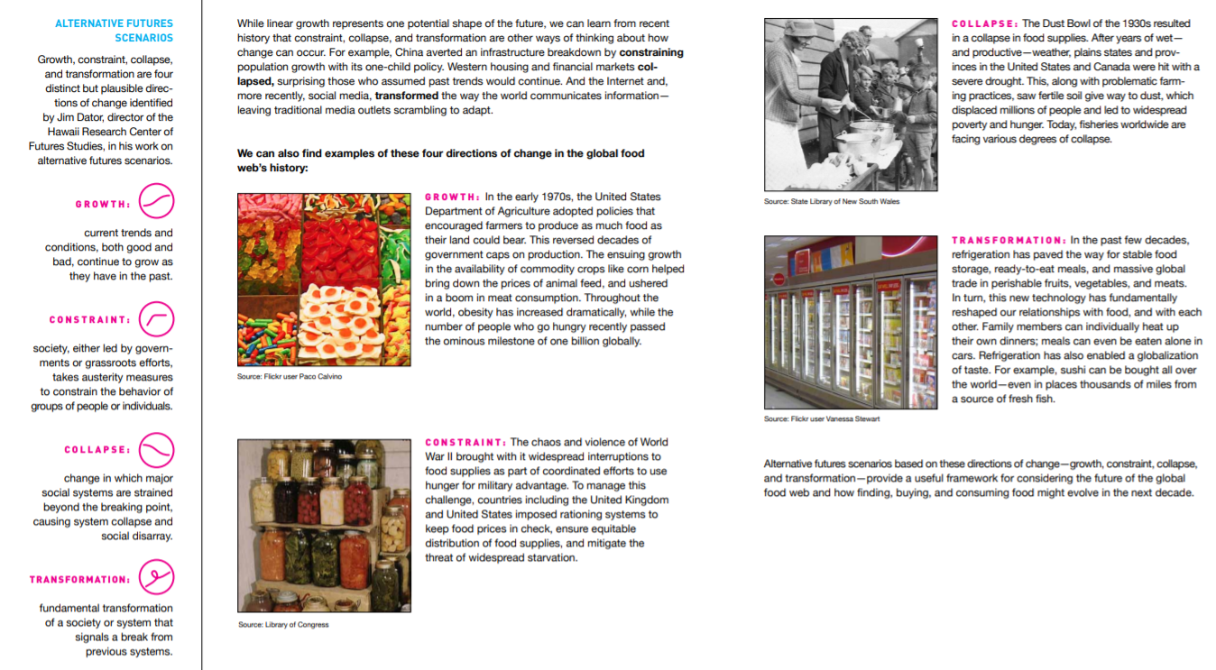
Examples: Four Futures
Notes:
Need to create form for ‘Context of Change’ deliverable

Slide 17
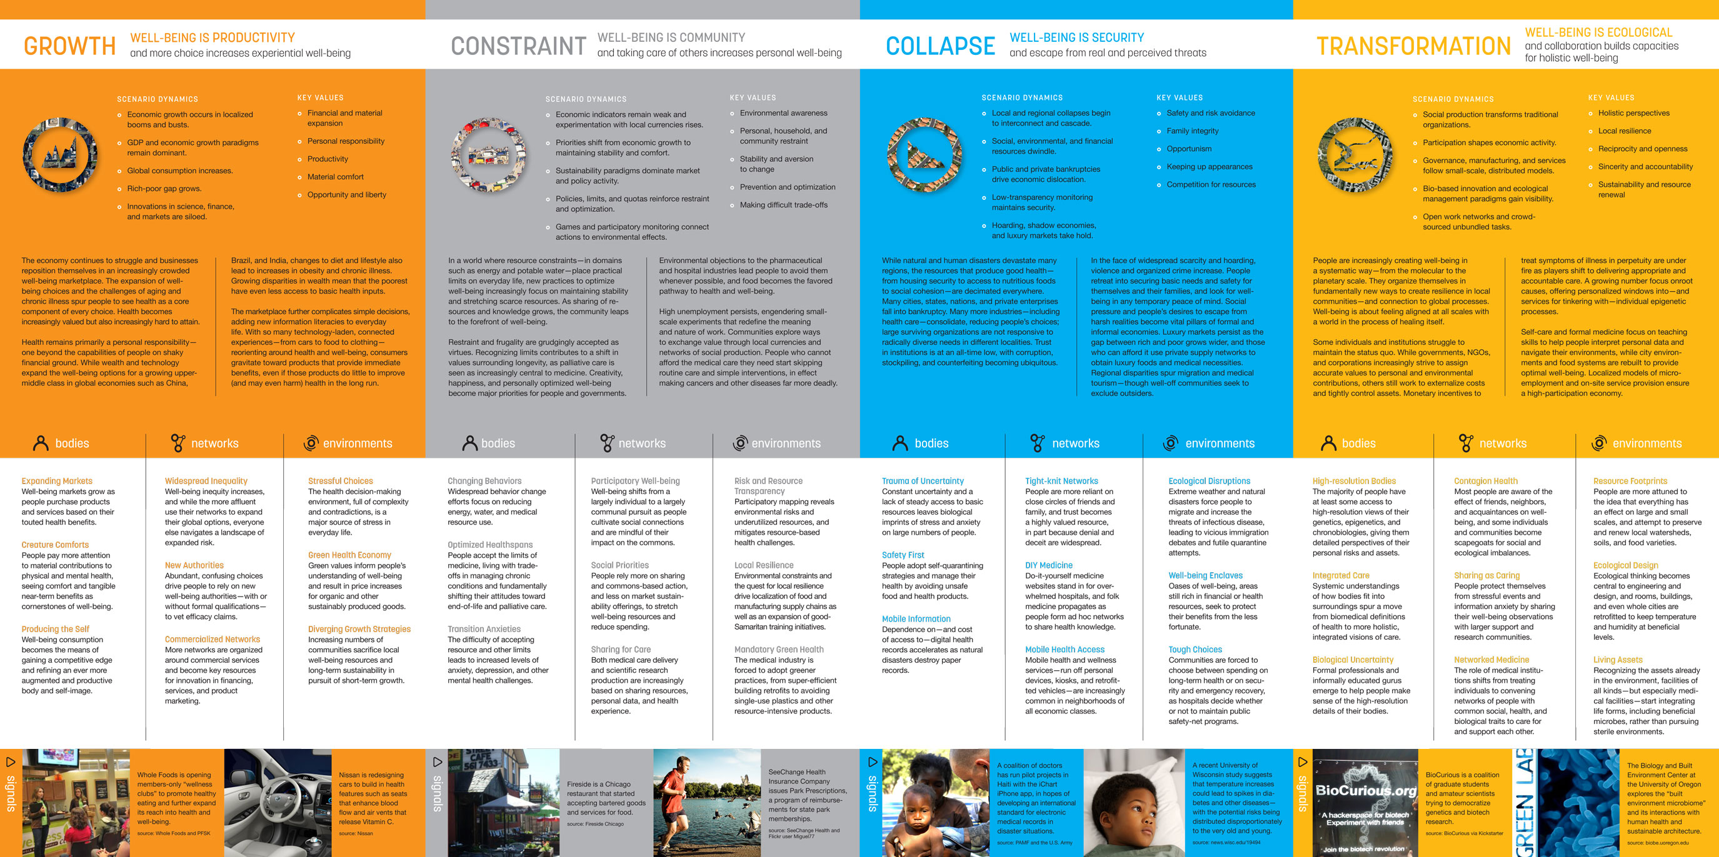
Notes:
Need to create form for ‘Context of Change’ deliverable

